Slide 1
Black-box Testing

Slide 2
Black-box Testing
Complements white-box testing by uncovering different classes of errors
Focuses on the functional requirements and the information domain of the software
Used during the later stages of testing after white box testing has been performed
The tester identifies a set of input conditions that will fully exercise all functional requirements for a program
The test cases satisfy the following:
  Reduce the number of additional test cases that must be designed to achieve reasonable testing
  Tell us something about the presence or absence of classes of errors, rather than an error associated only with the specific task at hand

Slide 3
Black-box Testing Categories
Incorrect or missing functions
Interface errors
Errors in data structures or external data base access
Behavior or performance errors
Initialization and termination errors

Slide 4
Questions answered by
Black-box Testing
How is functional validity tested?
How are system behavior and performance tested?
What classes of input will make good test cases?
Is the system particularly sensitive to certain input values?
How are the boundary values of a data class isolated?
What data rates and data volume can the system tolerate?
What effect will specific combinations of data have on system operation?

Slide 5
Equivalence Partitioning
A black-box testing method that divides the input domain of a program into classes of data from which test cases are derived
An ideal test case single-handedly uncovers a complete class of errors, thereby reducing the total number of test cases that must be developed
Test case design is based on an evaluation of equivalence classes for an input condition
An equivalence class represents a set of valid or invalid states for input conditions
From each equivalence class, test cases are selected so that the largest number of attributes of an equivalence class are exercise at once

Slide 6
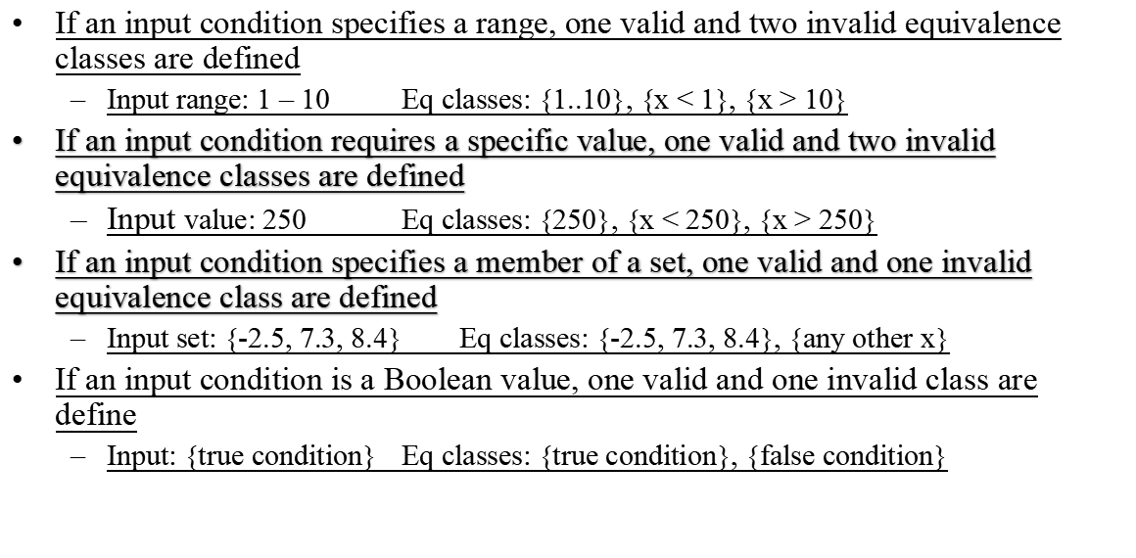
Guidelines for Defining Equivalence Classes

Slide 7
Boundary Value Analysis
A greater number of errors occur at the boundaries of the input domain rather than in the "center"
Boundary value analysis is a test case design method that complements equivalence partitioning
  It selects test cases at the edges of a class
  It derives test cases from both the input domain and output domain

Slide 8
Guidelines for
Boundary Value Analysis
1. If an input condition specifies a range bounded by values a and b, test cases should be designed with values a and b as well as values just above and just below a and b
2. If an input condition specifies a number of values, test case should be developed that exercise the minimum and maximum numbers. Values just above and just below the minimum and maximum are also tested
Apply guidelines 1 and 2 to output conditions; produce output that reflects the minimum and the maximum values expected; also test the values just below and just above
If internal program data structures have prescribed boundaries (e.g., an array), design a test case to exercise the data structure at its minimum and maximum boundaries

Slide 9
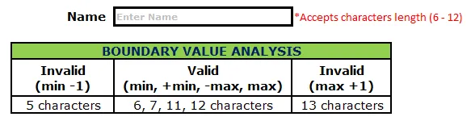
Boundary Value Analysis
Example
Assume we have to test a text field (Name) which accepts the length between 6-12 characters

Slide 10
Boundary Value Analysis
BVA is based on the single fault assumption, also known as critical fault assumption which states that failures are rarely the product of two or more simultaneous faults. That is faults are very rarely the result of the simultaneous occurrence of two or more faults. Hence while designing the test cases for BVA we keep all but one variable to the nominal value and allowing the remaining variable to take the extreme value.
Two fault assumption means that in test cases two of input variables assume their
boundary values while all remaining variables – their nominal values.
Generally, we can speak about N-fault assumption or multiple fault assumption
when the method requires a boundary value for all of program’s input variables for the test case.
If the test suite is generated according to single fault assumption and some test case fails, there is a good reason to suppose that the input parameter with boundary value is incorrectly processed. But such test suite will be bigger or more complex than a test suite generated according to N-fault assumption. On the other hand, if the test case generated according to N-fault assumption fails, it is a more complex task to say which boundary or boundaries were processed incorrectly

Slide 11
Guidelines for
Boundary Value Analysis
Test Case Design for BVA:
While designing the test cases for BVA first we determine the number of input variables in the problem. For each input variable, we then determine the range of values it can take. Then we determine the extreme values and nominal value for each input variable.
Consider an input variable t taking values in the range [l, r].Extreme values for t are –
t = l
t = l+1
t = r-1
t = r

Slide 12
Boundary Value Analysis
The nominal value for the variable can be any value in the range (l, r).
In most of the BVA implementations, it is taken as the middle value of the range (r+l)/2.
Under the single fault assumption, the total number of test cases in BVA for a problem with n inputs is 4n+1.
The 4n cases correspond to the test cases with the four extreme values of each variable keeping the other n-1 variable at nominal value. The one additional case is where all variables are held at a nominal value.

Slide 13
Boundary Value Analysis
Triangle Problem accepts three integers – a, b, c as three sides of the triangle .We also define a range for the sides of the triangle as [l, r] where l>0. It returns the type of triangle (Scalene, Isosceles, Equilateral, Not a Triangle) formed by a, b, c.
For a, b, c to form a triangle the following conditions should be satisfied –
a < b+c
b < a+c
c < a+b
If any of these conditions is violated output is Not a Triangle.
For Equilateral Triangle all the sides are equal.
For Isosceles Triangle exactly one pair of sides is equal.
For Scalene Triangle all the sides are different.

Slide 14
Boundary Value Analysis
The table shows the Test Cases Design for the Triangle Problem.The range value [l, r] is taken as [1, 100] and nominal value is taken as 50.
The total test cases is,
4n+1 = 4*3+1 = 13

Slide 15
Boundary Value Analysis
TEST CASE ID | A | B | C | EXPECTED OUTPUT
T1 | 1 | 50 | 50 | Isosceles
T2 | 2 | 50 | 50 | Isosceles
T3 | 99 | 50 | 50 | Isosceles
T4 | 100 | 50 | 50 | Not a Traingle
T5 | 50 | 50 | 50 | Equilateral
T6 | 50 | 1 | 50 | Isosceles
T7 | 50 | 2 | 50 | Isosceles
T8 | 50 | 99 | 50 | Isosceles
T9 | 50 | 100 | 50 | Not a Triangle
T10 | 50 | 50 | 1 | Isosceles
T11 | 50 | 50 | 2 | Isosceles
T12 | 50 | 50 | 99 | Isosceles
T13 | 50 | 50 | 100 | Not a Triangle

Slide 16
Robustness Testing
Robustness testing can be seen as and extension of Boundary Value Analysis.
In addition to the aforementioned 5 testing values (min, min+, nom, max-, max) we use two more values for each variable (min-, max+), which are designed to fall just outside of the input range.
If we adapt our function f to apply to Robustness testing we find the following equation:
f = 6n + 1
Robustness testing ensues a sway in interest, where the previous interest lied in the input to the program, the main focus of attention associated with Robustness testing comes in the expected outputs when and input variable has exceeded the given input domain

Slide 17
Worst Case Testing
To generate test cases we take the original 5-tuple set (min, min+, nom, max-, max) and
perform the Cartesian product of these values. The end product is a much larger set of results than we have seen before.
To compare we can see that Boundary Value Analysis results in 4n + 1 test
case where Worst-Case testing results in 5n(five raise to power n) test cases. As each variable has to assume each of its variables for each permutation (the Cartesian product) we have 5 to the n test cases. For this reason Worst-Case testing is generally used for situations that require a higher degree of testing (where failure of the program would be very costly)with less regard for the time and effort required as for many situations this can be too expensive to justify

Slide 18
Random Testing

Slide 19
What is Random Testing?
Random Testing, also known as monkey testing, is a form of functional black box testing that is performed when there is not enough time to write and execute the tests.

Slide 20
Random Testing
Is done to uncover:
Fault Behavior
Data Validation
Checking specifications

Slide 21
Why it is Done
This testing Shows the presence of Bugs, not absence of Bugs
So basically uncover the existence of bugs
Before the final release
Not to be done as a primary testing
To be done in conjunction with other forms of testing

Slide 22
Random Testing Characteristics:
Random testing is performed where the defects are NOT identified in regular intervals.
Random input is used to test the system's reliability and performance.
Saves time and effort than actual test efforts.

Slide 23
Random Testing Steps
Random Inputs are identified to be evaluated against the system.
Test Inputs are selected independently from test domain.
Tests are Executed using those random inputs.
Record the results and compare against the expected outcomes.
Reproduce/Replicate the issue and raise defects, fix and retest.

Slide 24
Example
A particular text field accepts only alpha characters. Which of the following is invalid Equivalence Partition?
a. APPLE
b. apple
c. aPPle
d. a2pple

Slide 25
Example
Which of the following values for age are in the same Equivalence Partition?
- If you are less than 18, you are too young to be registered for program.
- Between 18 and 50 inclusive, you will receive a 20% discount.
- Anyone over 50 is not eligible for a discount.
a.17, 18, 19
b. 51, 52, 53
c. 18, 49, 50
d. 17, 49, 51

Slide 26
Example
One of the fields on a form contains a text box that accepts numeric values in the range of 18 to 25. Identify the invalid Equivalence class.
a) 17
b) 19
c) 24
d) 21

Slide 27
Example
In an Examination, a candidate has to score a minimum of 24 marks in order to clear the exam. The maximum that he can score is 40 marks. Identify the Valid Equivalence values if the student clears the exam.
a) 22,23,26
b) 21,39,40
c) 29,30,31
d) 0,15,22

Slide 28
Example
One of the fields on a form contains a text box that accepts alphanumeric values. Identify the Valid Equivalence class
a) BOOK
b) Book
c) Boo01k
d) Book

Slide 29
Example
The Switch is switched off once the temperature falls below 18 and then it is turned on when the temperature is more than 21. When the temperature is more than 21. Identify the Equivalence values which belong to the same class.
a) 12,16,22
b) 24,27,17
c) 22,23,24
d) 14,15,19

Slide 30
Example
A program validates a numeric field as follows: values less than 10 are rejected, values equal and between 10 and 21 are accepted, values greater than or equal to 22 are rejected. Which of the following input values cover all of the equivalence partitions?
a. 10,11,21
b. 3,20,21
c. 3,10,22
d. 10,21,22

Slide 31
Example
A program validates a numeric field as follows: values less than 10 are rejected, values between 10 and 21 are accepted, values greater than or equal to 22 are rejected. Which of the following covers the MOST boundary values?
a. 9,10,11,22
b. 9,10,21,22
c. 10,11,21,22
d. 10,11,20,21

Slide 32
Example
In a system designed to work out the tax to be paid:
An employee has £4000 of salary tax-free.
The next £1500 is taxed at 10%.
The next £28000 after that is taxed at 22%.
Any further amount is taxed at 40%.
To the nearest whole pound, which of these groups of numbers fall into three DIFFERENT equivalence classes?
a) £4000; £5000; £5500
b) £32001; £34000; £36500
c) £28000; £28001; £32001
d) £4000; £4200; £5600

Slide 33
Example
Given the following specification, which of the following values for age are in the SAME equivalence partition?
If you are less than 18, you are too young to be insured.
Between 18 and 30 inclusive, you will receive a 20% discount.
Anyone over 30 is not eligible for a discount.
a) 17, 18, 19
b) 29, 30, 31
c) 18, 29, 30
d) 17, 29, 31

Slide 34
Example
Which of the following values for age are in the same Equivalence Partition?
- If you are less than 18, you are too young to be registered for program.
- Between 18 and 50 inclusive, you will receive a 20% discount.
- Anyone over 50 is not eligible for a discount.
a.17, 18, 19
b. 51, 52, 53
c. 18, 49, 50
d. 17, 49, 51

